Slide 1
YCSB
CCBD ASSIGNMENT - TASK 2
Abhijnana Kashyap (CSE)
PES1201800155
abhijnanakashyap@gmail.com
Aditi HK (CSE)
PES1201801027
aditihk@gmail.com
Prajwal K Naik (CSE)
PES1201801455
naikprajwal40@gmail.com
Swanuja Maslekar (CSE)
PES1201800369
swanuja2000@gmail.com

Slide 2
What is YCSB?
The Yahoo! Cloud Serving Benchmark is an open source framework for evaluating and comparing the performance of multiple types of data-serving systems. It is often used to compare the relative performance of NoSQL database management systems.
It consists of the YCSB Client and the core workloads.

Slide 3
NoSQL Databases
NoSQL databases store data differently than relational databases and are non-tabular. They provide flexible schemas, work well with large amounts of data and high user loads and can store relational data too.
As storage costs decreased, the need for data applications for storage and queries increased. The need for defining the scheme in advance became challenging as the data came in different shapes and sizes. This is when NoSQL databases became popular as it allowed the users flexibility to store large amounts of data.

Slide 4
Cloud Computing
Along with NoSQL databases, cloud computing also rose to popularity. Developers began using public clouds to host their application and data. They wanted the ability to distribute data across multiple servers and regions to make their applications resilient, to scale-out instead of scale-up, and to intelligent geo-place their data.
MongoDB is a NoSQL database and this is the database that was used in our assignment.

Slide 5
Core Workloads
Workload A : Update heavy workload
This workload has a mix of 50/50 reads and writes.
Workload B : Read mostly workload
This workload has a 95/5 read/write mix.
Workload C : Read only
This workload is 100% read.
Workload D : Read latest workload
In this workload, new records are inserted and the most recent inserted records are the most popular.
Workload E : Short ranges
In this workload, short ranges of record are queried instead of individual records.
Workload F : Read-modify-write
In this workload, the client will read a record, modify it and write back the changes.

Slide 6
Installations required
All the installations were done on virtualbox with Ubuntu 18.04 os.
Java
Maven
git
MongoDB - NoSQL database
YCSB

Slide 7
Execution
For each workload, the recordcount was varied from 100k-500k. After the workload was executed for a recordcount, the contents of the database was cleared before the next execution. This was done by opening the mongo command shell and by executing the following commands -
use <database_name>
db.dropDatabase
Data was loaded using YCSB. The workload and runtime parameters such as threadcount was chosen for each execution.
Workload is applied by the YCSB client and after running it, the client will report the required values such as latency and throughput as output.

Slide 8
Execution
Load command -
./bin/ycsb load mongodb -s -P workloads/workload<workload> -t -p recordcount=<recordcount> -threads 16 -p mongodb.url="mongodb://localhost:27017/yscb" -p mongodb.auth="true"

Slide 9
Execution
Run command -
For workloads A,B and C -
./bin/ycsb run mongodb -s -t -P workloads/<workload> -p operationcount=<recordcount> -threads 16 -p mongodb.url="mongodb://localhost:27017/yscb" -p mongodb.auth="true"
For workloads D, E and F -
./bin/ycsb run mongodb -s -t -P workloads/<workload> -p recordcount=<recordcount> -p operationcount=<recordcount> -threads 16 -p mongodb.url="mongodb://localhost:27017/yscb" -p mongodb.auth="true"

Slide 10
Result
The values generated for throughput and latency were recorded and these were plotted into two graphs -
Recordcount vs Latency
Recordcount vs Throughput

Slide 11
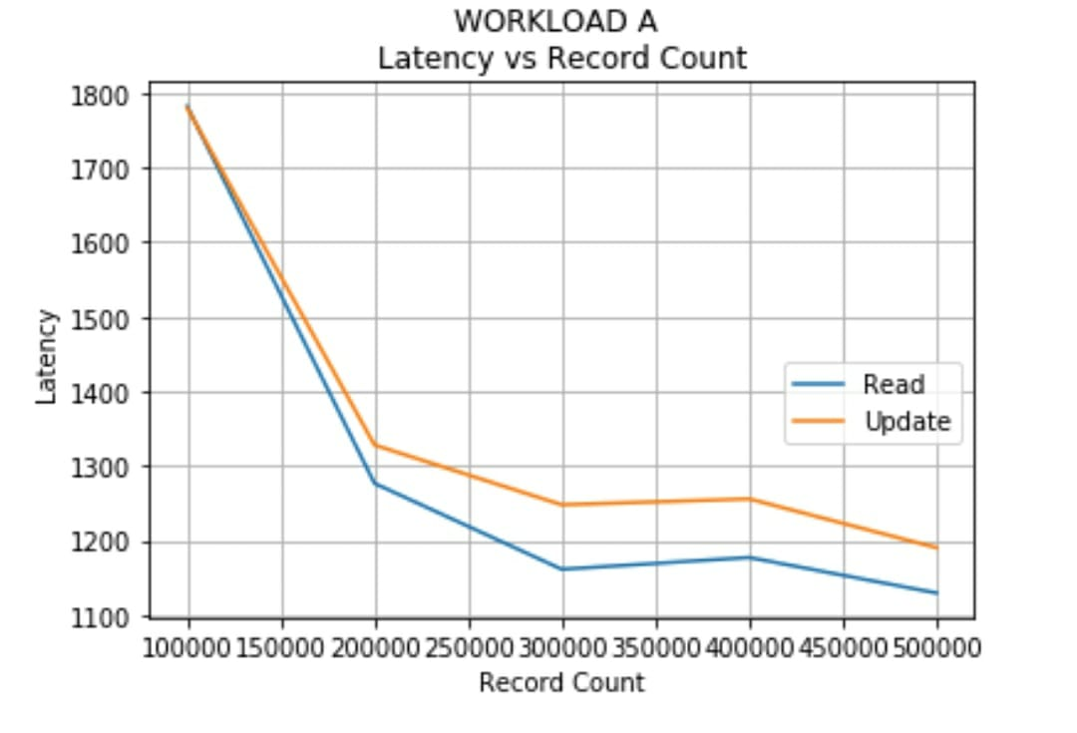
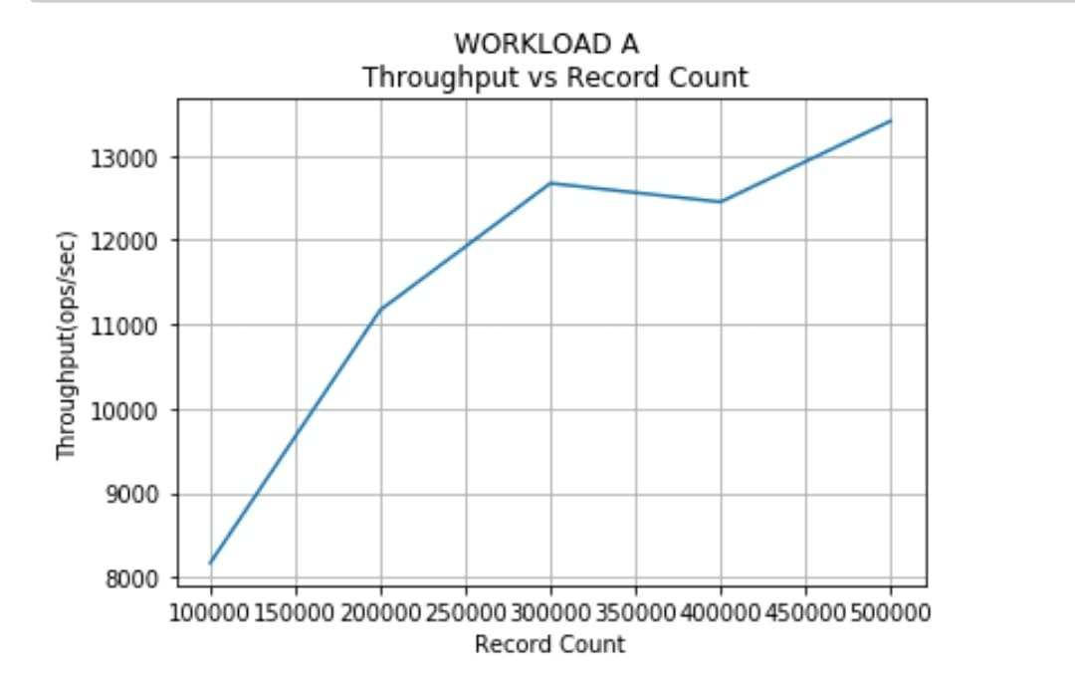
Graphs for workload A

Slide 12
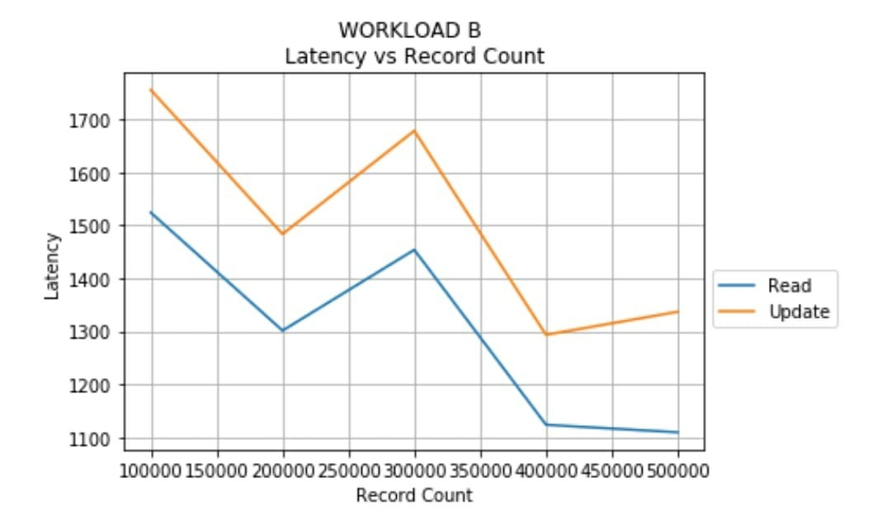
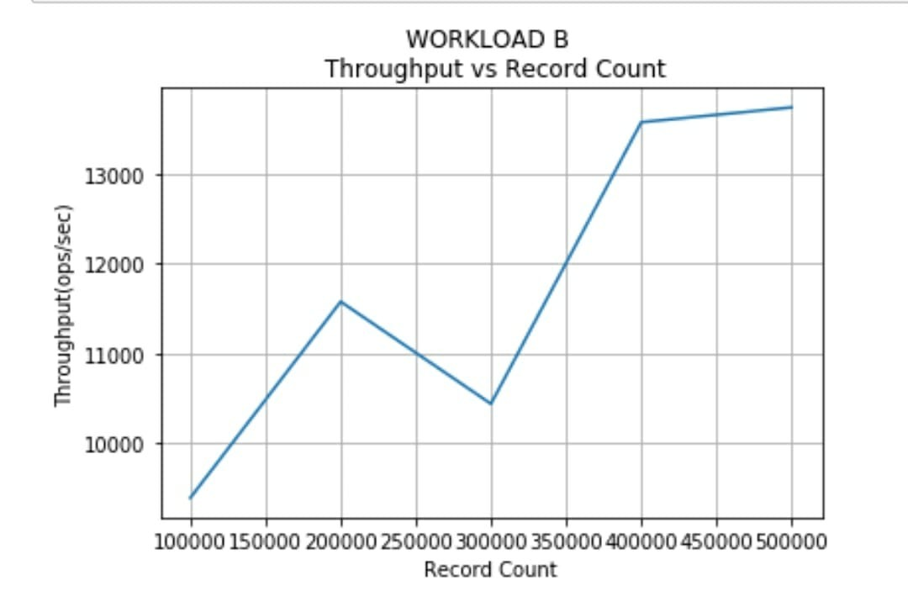
Graphs for workload B

Slide 13
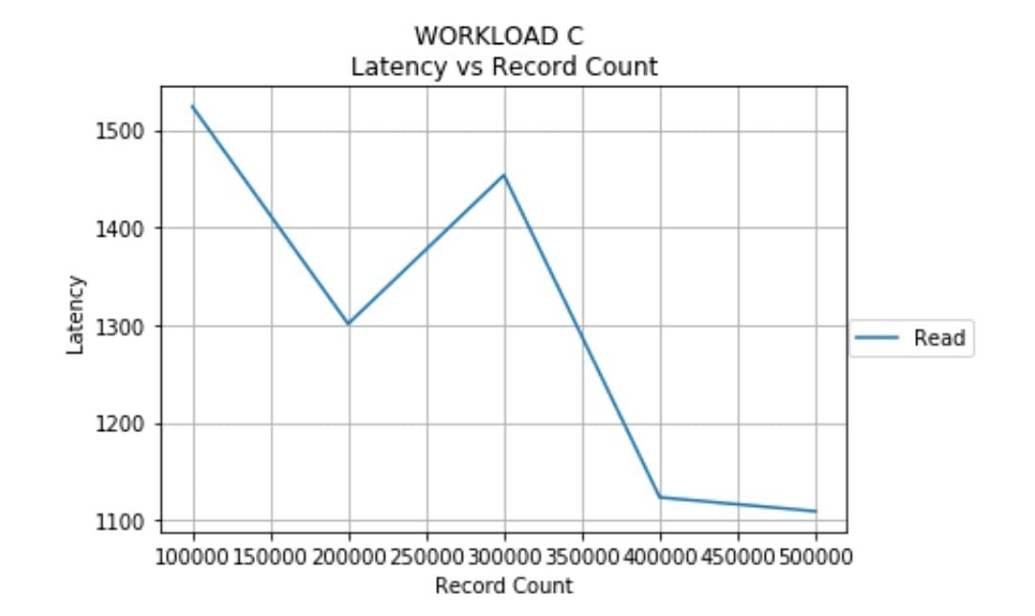
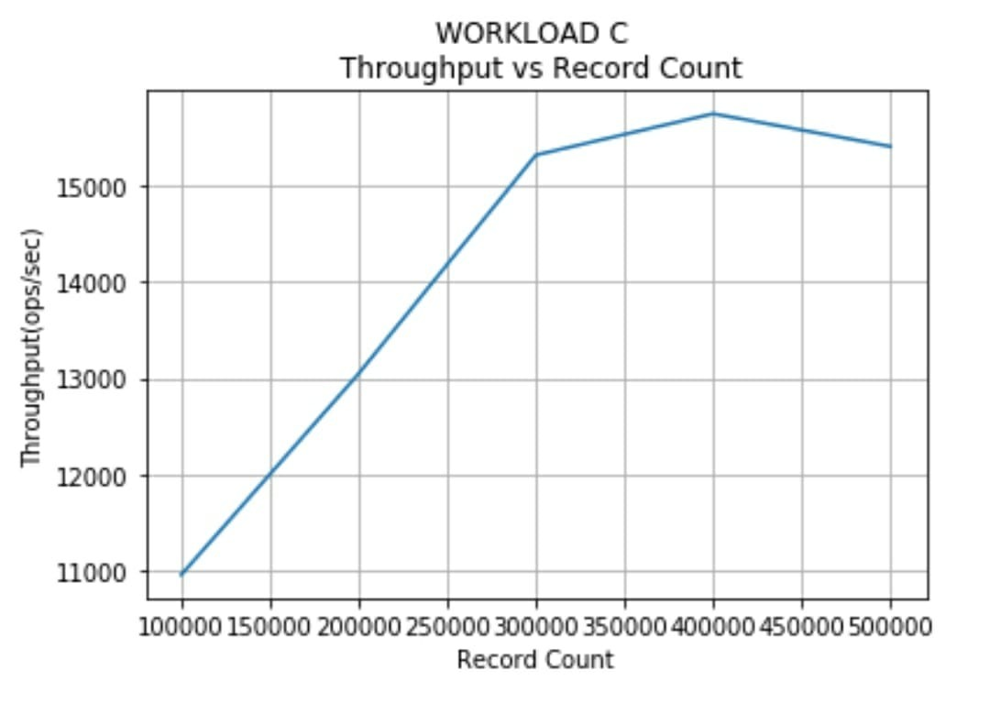
Graphs of workload C

Slide 14
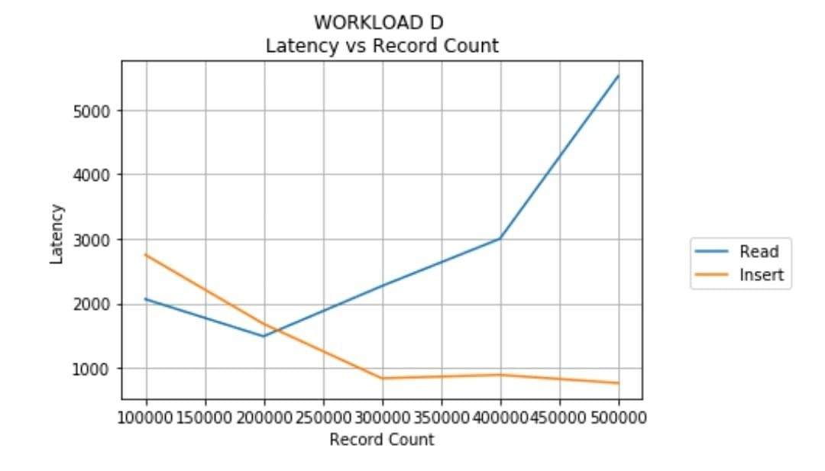
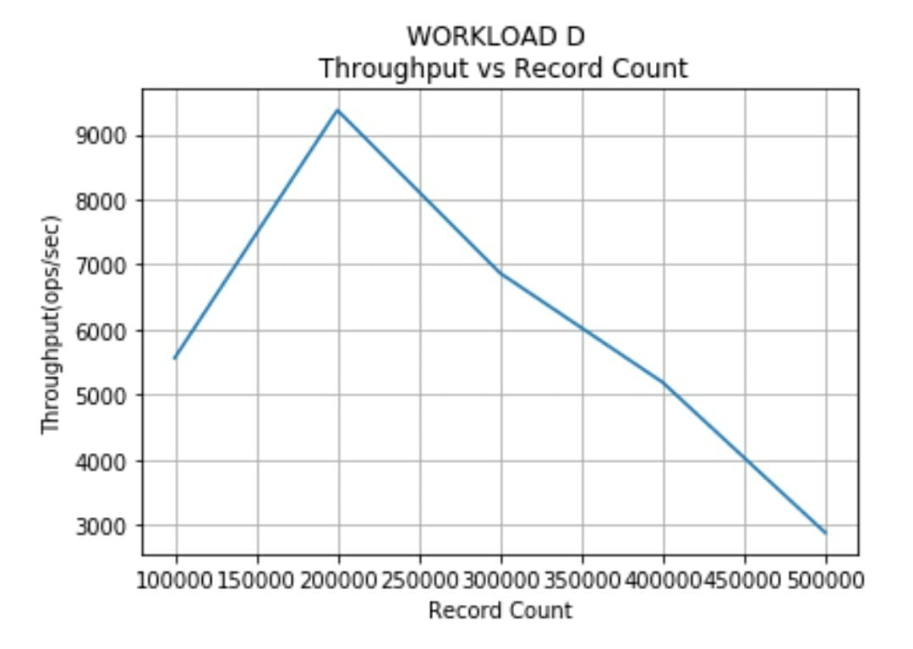
Graphs of workload D

Slide 15
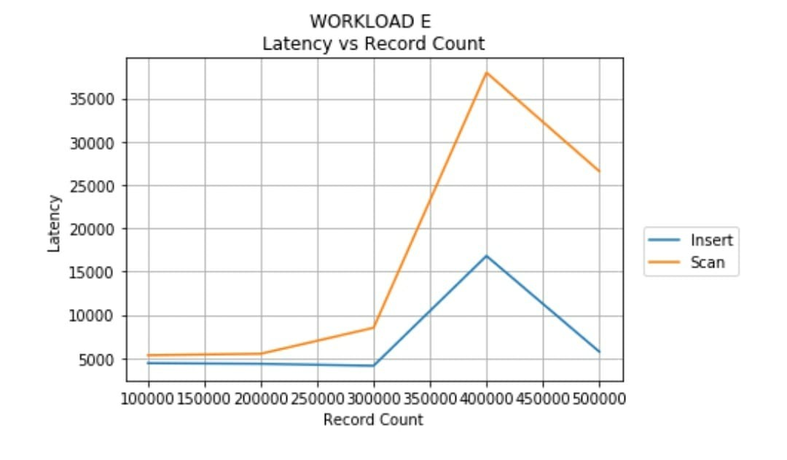
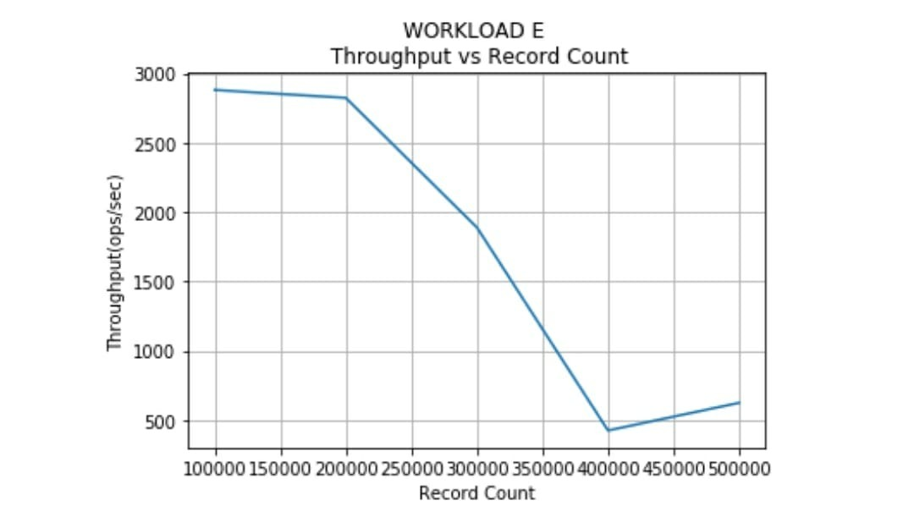
Graphs of workload E

Slide 16
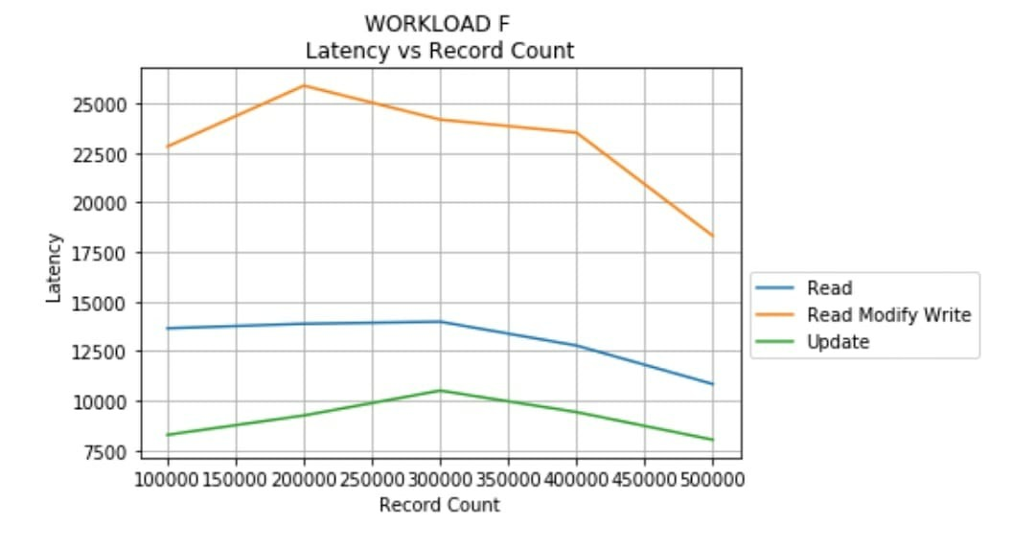
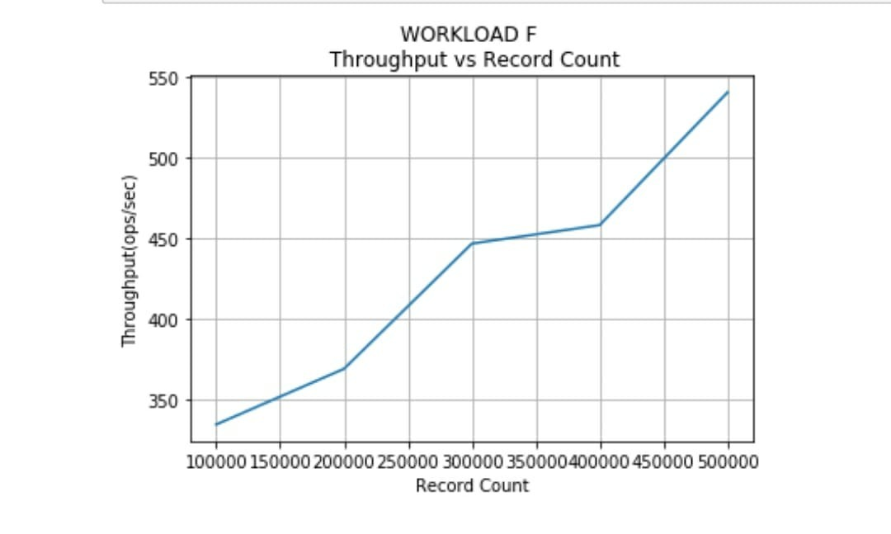
Graphs of workload F

Slide 17
Thank you.

